Slide 1
LAB3
Team Members
Aung Naing Oo
Mohit
Gary
Jennifer
Hwee Ting

Slide 2



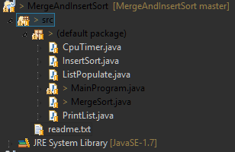

Slide 3
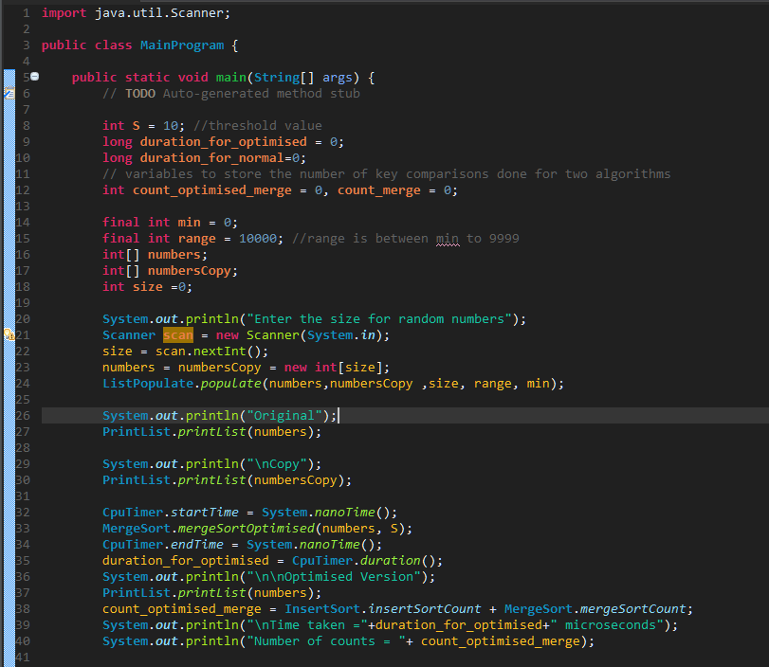


Slide 4
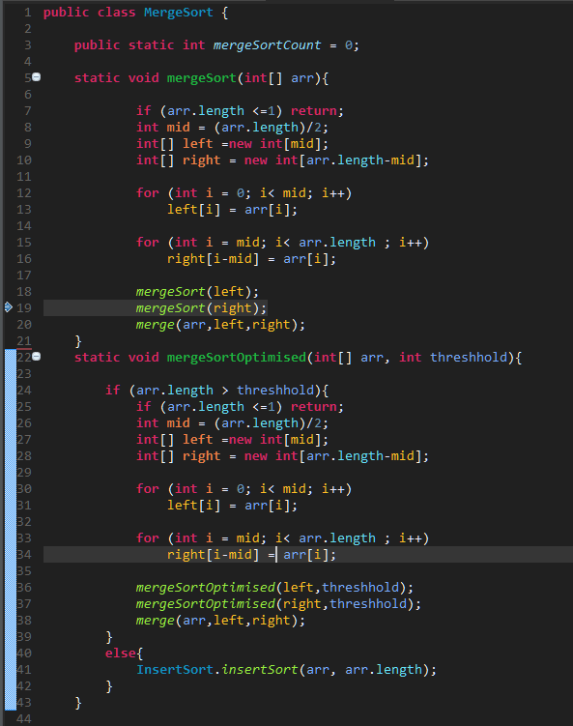
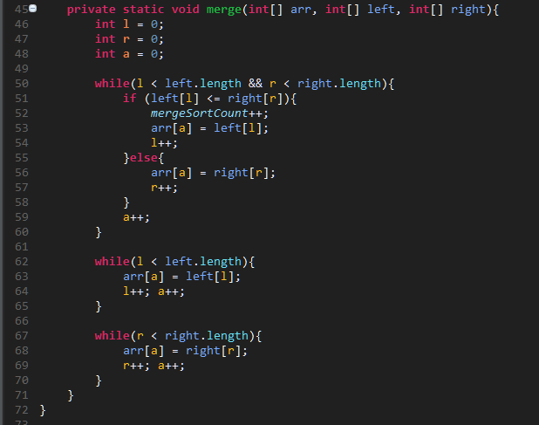

Slide 5
